Slide 1

Intelligent Drowsiness Monitor For Safer Driving
Team 07
Team Members
Himanshu Shekhar
Abhinav Kumar Pathak
Abhilash Anand
Rishi Pradeep Sharma
4
3
2
1

Slide 2

Problem Statement
A car accident is the major cause of death in which around 1.3 million people die every year. The majority of these accidents are caused because of distraction or the drowsiness of the driver. Construction of high-speed highway roads had diminished the margin of error for the driver. The countless number of people drive for long-distance every day and night on the highway. Lack of sleep may lead to an accident. According to the National Highway Traffic Safety Administration and the Centre’s for Disease Control and Prevention they say that it is 7 times dangerous driving tired to driving drunk. Drivers must keep a close eye on the road, so they can react to sudden events immediately.
Notes:
Notes to presenter:
Description of what you learned in your own words on one side.
Include information about the topic
Details about the topic will also be helpful here.
Tell the story of your learning experience. Just like a story there should always be a beginning, middle and an end.
On the other side, you can add a graphic that provides evidence of what you learned.
Feel free to use more than one slide to reflect upon your process. It also helps to add some video of your process.

Slide 3
Key Facts
Nearly 1.25 million people die in road crashes each year, on average 3,287 deaths a day and an additional 20-50 million are injured or disabled.
More than half of all road traffic deaths occur among young adults ages 15-44.
Road crashes are the leading cause of death among young people ages 15-29, and Each year nearly 400,000 people under 25 die on the world’s roads, on average over 1,000 a day.
Over 90% of all road fatalities occur in low and middle-income countries, which have less than half of the world’s vehicles.
Road crashes cost USD $518 billion globally, costing individual countries from 1-2% of their annual GDP.
Road crashes cost low and middle-income countries USD $65 billion annually, exceeding the total amount received in developmental assistance.
Unless action is taken, road traffic injuries are predicted to become the fifth leading cause of death by 2030.

Slide 4

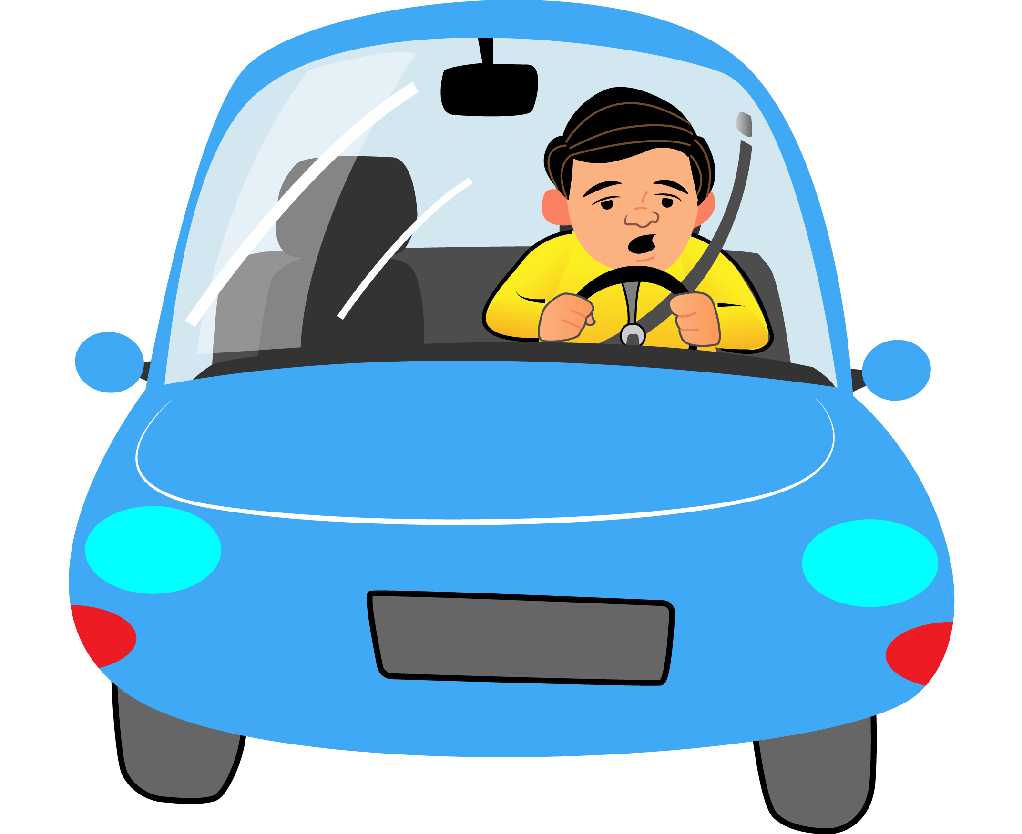
Proposed Method
There are several different algorithms and methods for eye tracking, and monitoring. Most of them in some way relate to features of the eye (typically reflections from the eye) within a video image of the driver. The original aim of this project was to use the retinal reflection as a means to finding the eyes on the face, and then using the absence of this reflection as a way of detecting when the eyes are closed. Applying this algorithm on consecutive video frames may aid in the calculation of eye closure period. Eye closure period for drowsy drivers are longer than normal blinking. It is also very little longer time could result in severe crash. So we will warn the driver as soon as closed eye is detected.

Slide 5
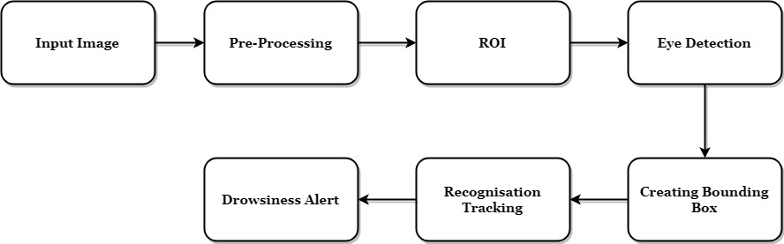
Block Diagram

Slide 6

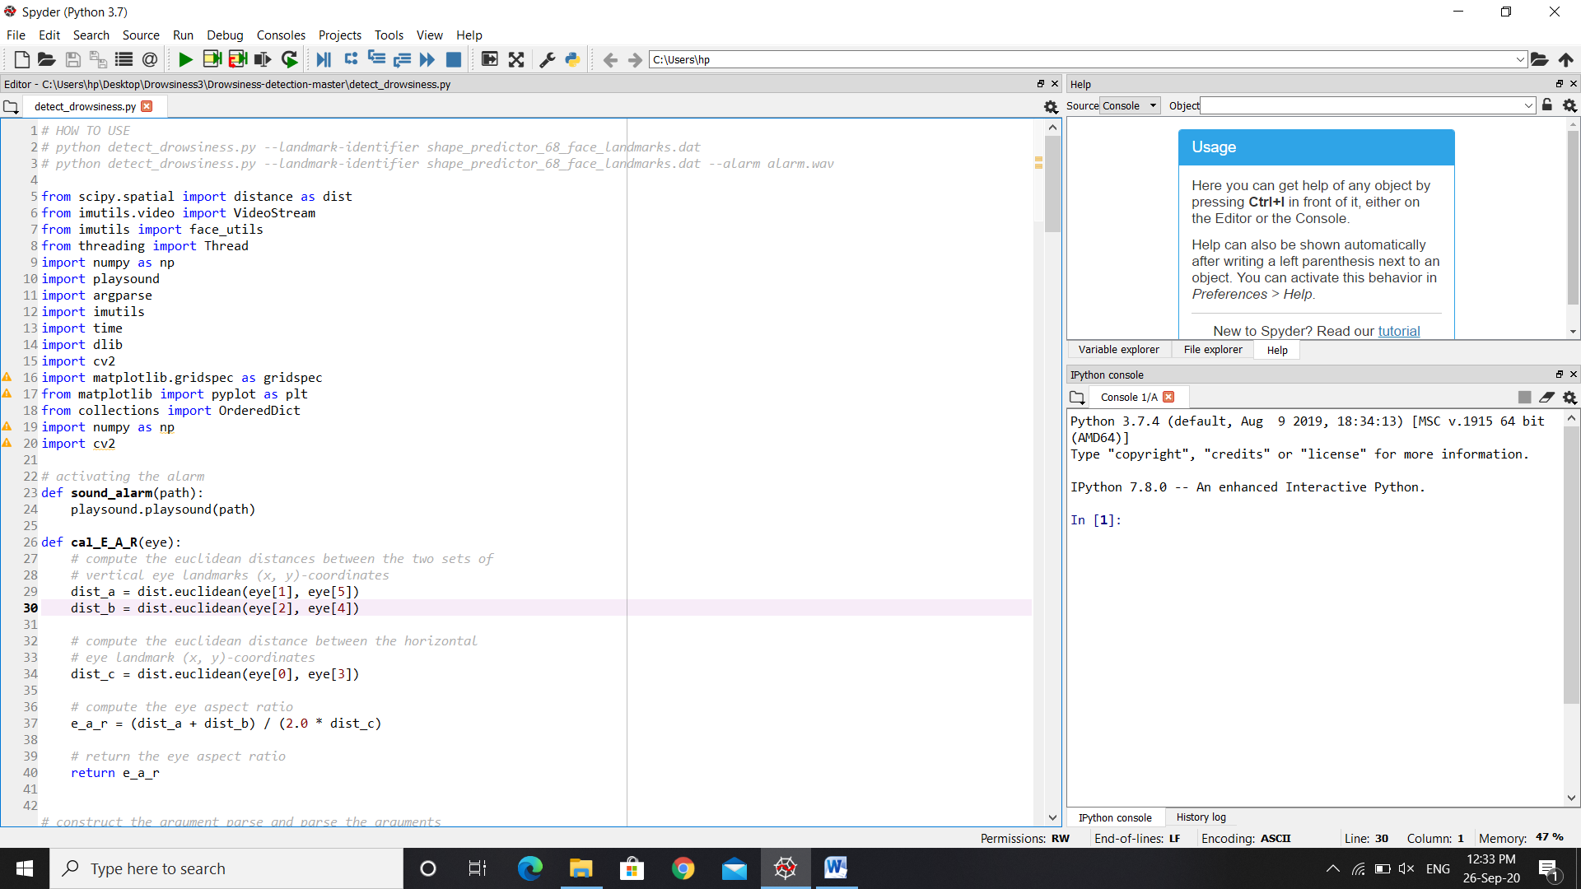
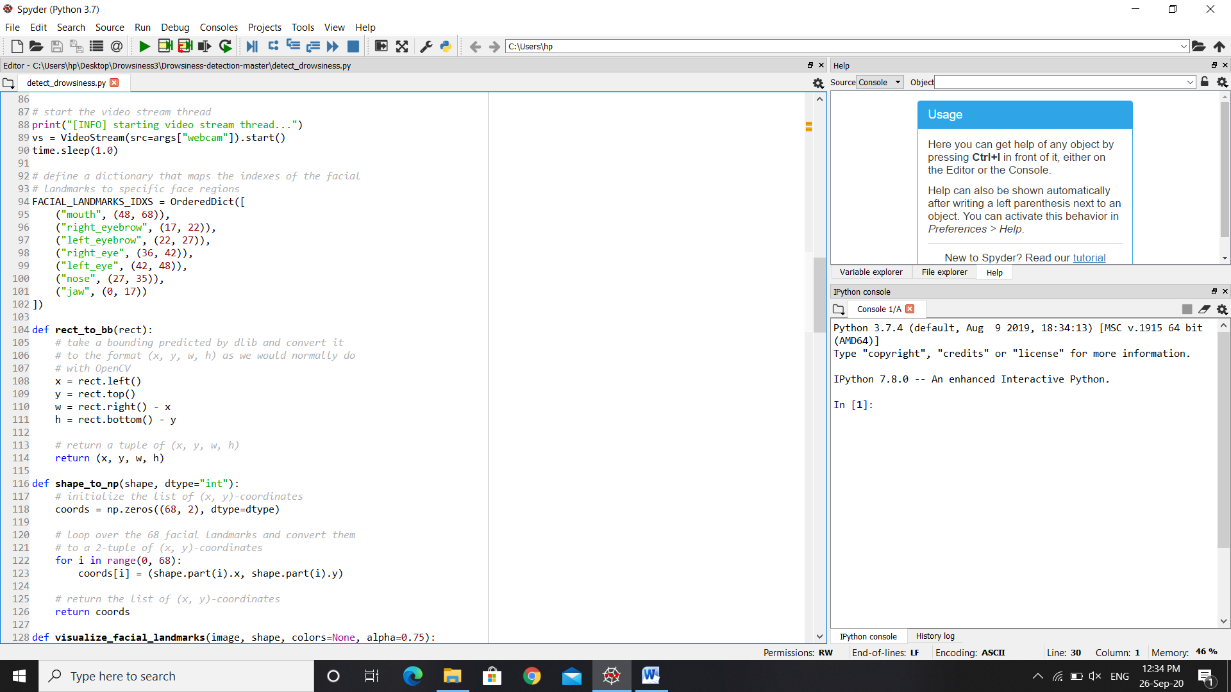
Snapshots

Slide 7

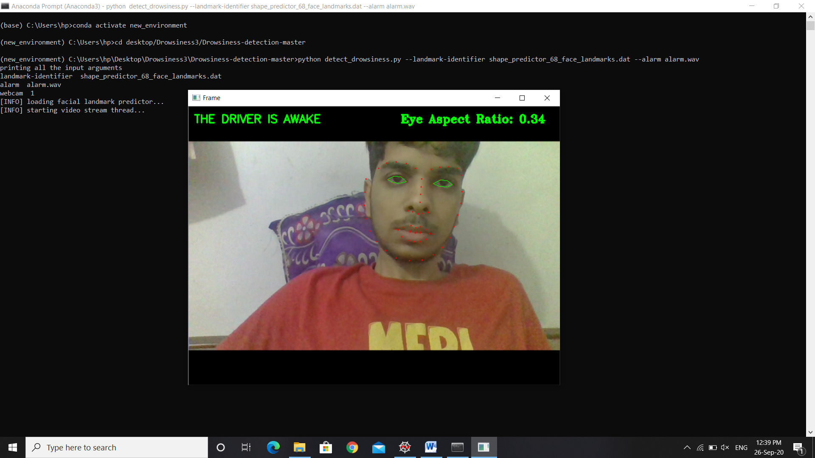

Slide 8
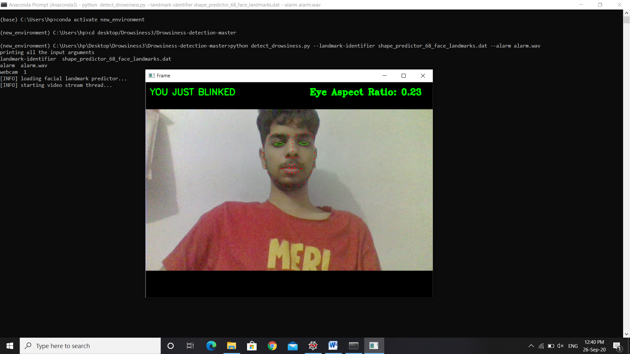
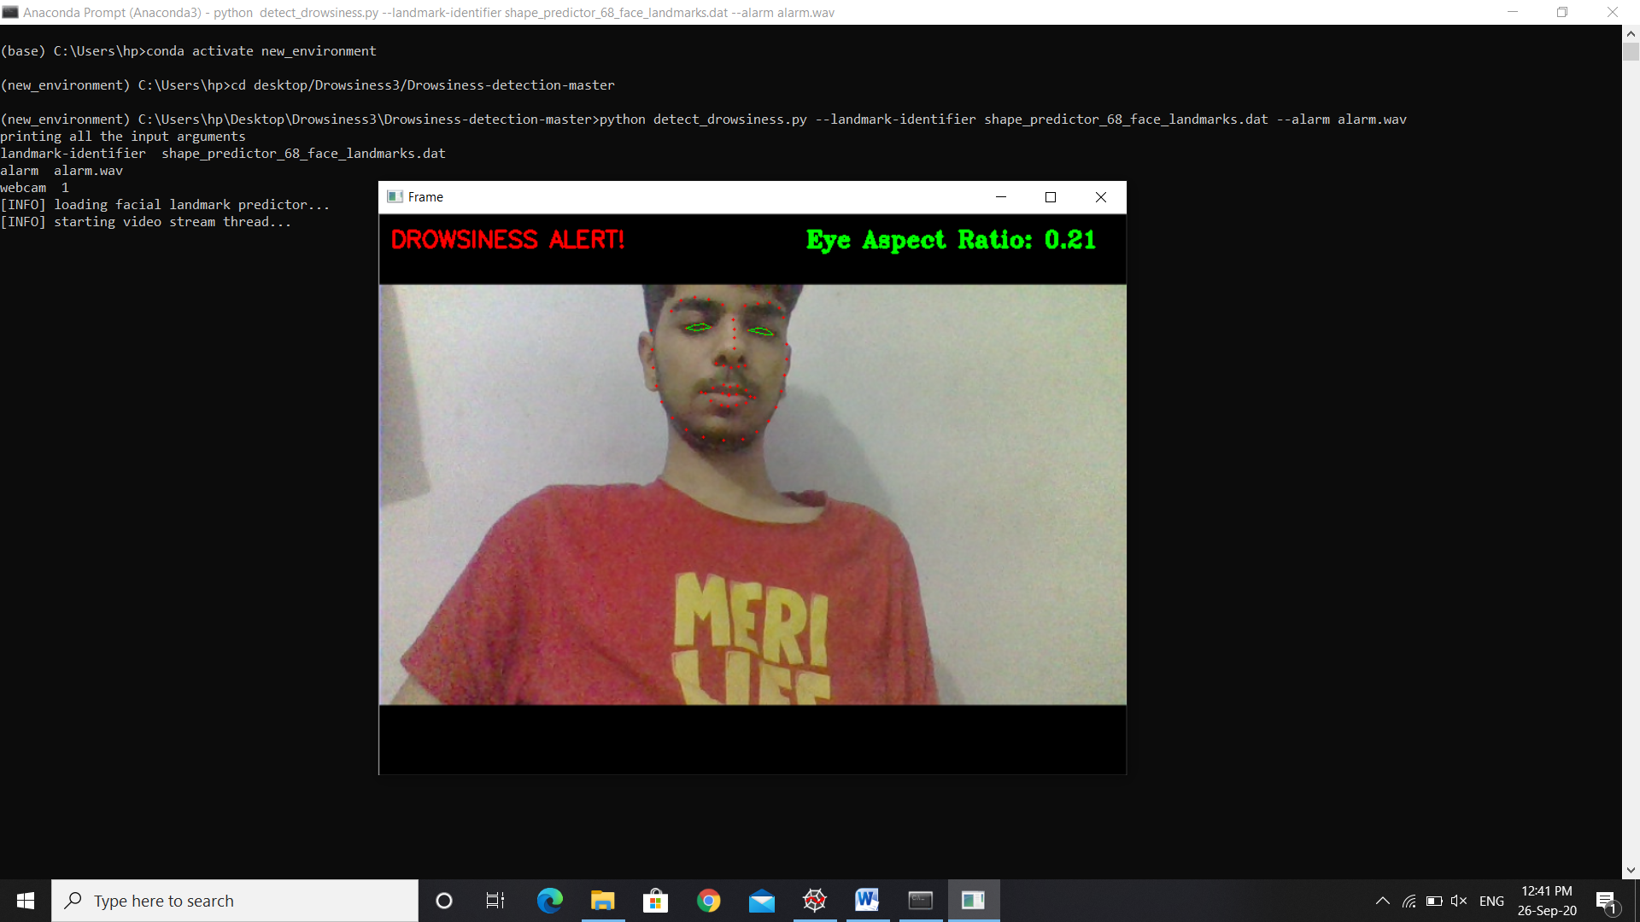

Slide 9
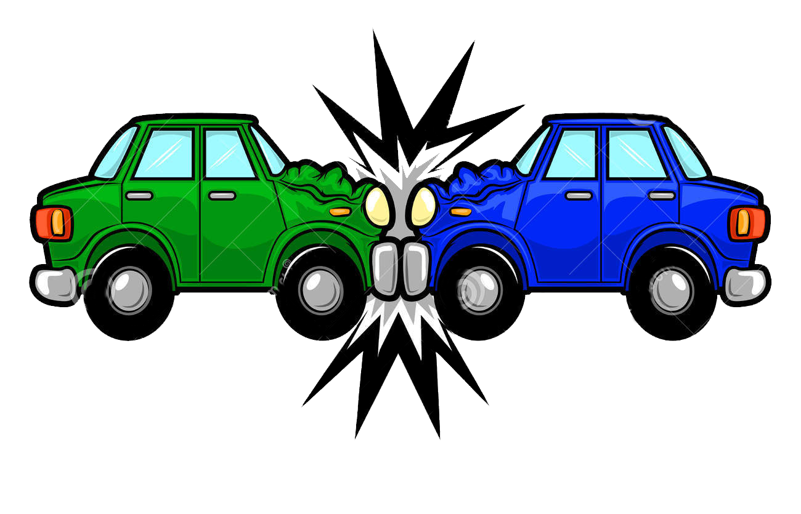
Benefits
The drowsiness detection and alert system is step forward to avoid road and highway accidents in future

Slide 10
Result
Implementation of drowsiness detection with Python and OpenCV was done which includes the following steps: Successful runtime capturing of video with camera. Captured video was divided into frames and each frame were analyzed. Successful detection of face followed by detection of eye. If closure of eye for successive frames were detected, then it is classified as drowsy condition else it is regarded as normal blink and the loop of capturing image and analyzing the state of driver is carried out again and again.

Slide 11
Conclusion
The driver abnormality monitoring system developed is capable of detecting drowsiness, drunken and reckless behaviours of driver in a short time. The Drowsiness Detection System developed based on eye closure of the driver can differentiate normal eye blink and drowsiness and detect the drowsiness while driving. The proposed system can prevent the accidents due to the sleepiness while driving. The system works well even in case of drivers wearing spectacles and even under low light conditions if the camera delivers better output. Information about the head and eyes position is obtained through various self-developed image processing algorithms. During the monitoring, the system is able to decide if the eyes are opened or closed. When the eyes have been closed for too long, a warning signal is issued. processing judges the driver’s alertness level on the basis of continuous eye closures.

Slide 12
THANK YOU

